Slide 1
Nutrition for singles

Slide 2
Chronic Disease Statistics
About 3 in 4 U.S. adults have at least one chronic disease
More than half have two or more chronic diseases.
More than 90% of adults 65+ have at least one chronic condition.
Heart disease remains a leading cause of death.
Chronic and mental health conditions account for about 90% of U.S. healthcare spending.

Slide 3
Nutrition
Nutrition affects nearly every body system
Good nutrition helps prevent many chronic diseases
Food affects energy, immunity, heart health, and brain function
Small dietary improvements can produce meaningful health benefits.

Slide 4
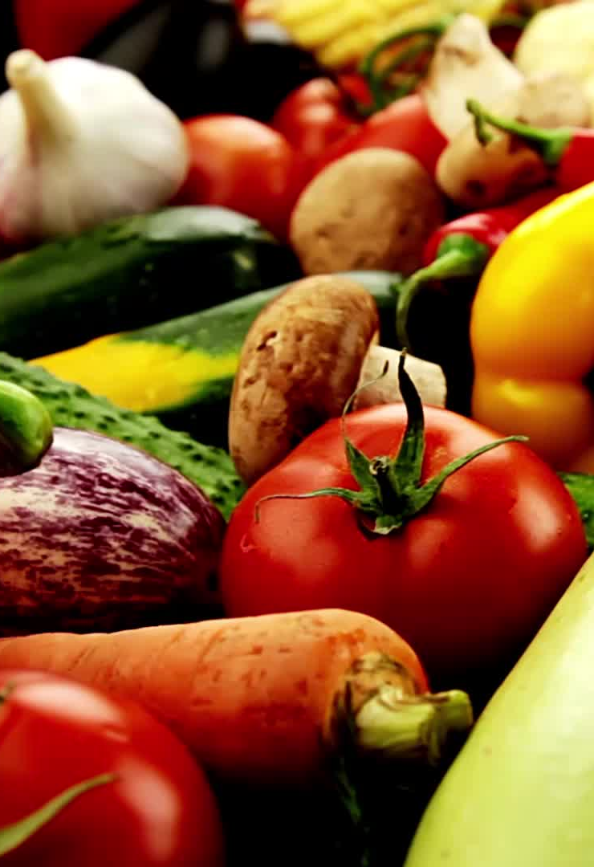
The Power of Food
Food can positively influence:
  Heart Disease
  Stroke
  Type 2 Diabetes
  Blood pressure
  Cholesterol
  Blood sugar
  Weight
  Inflammation
  Brain function
  Immune system
  Energy
  Fatty Liver Disease
  Some cancers

Slide 5
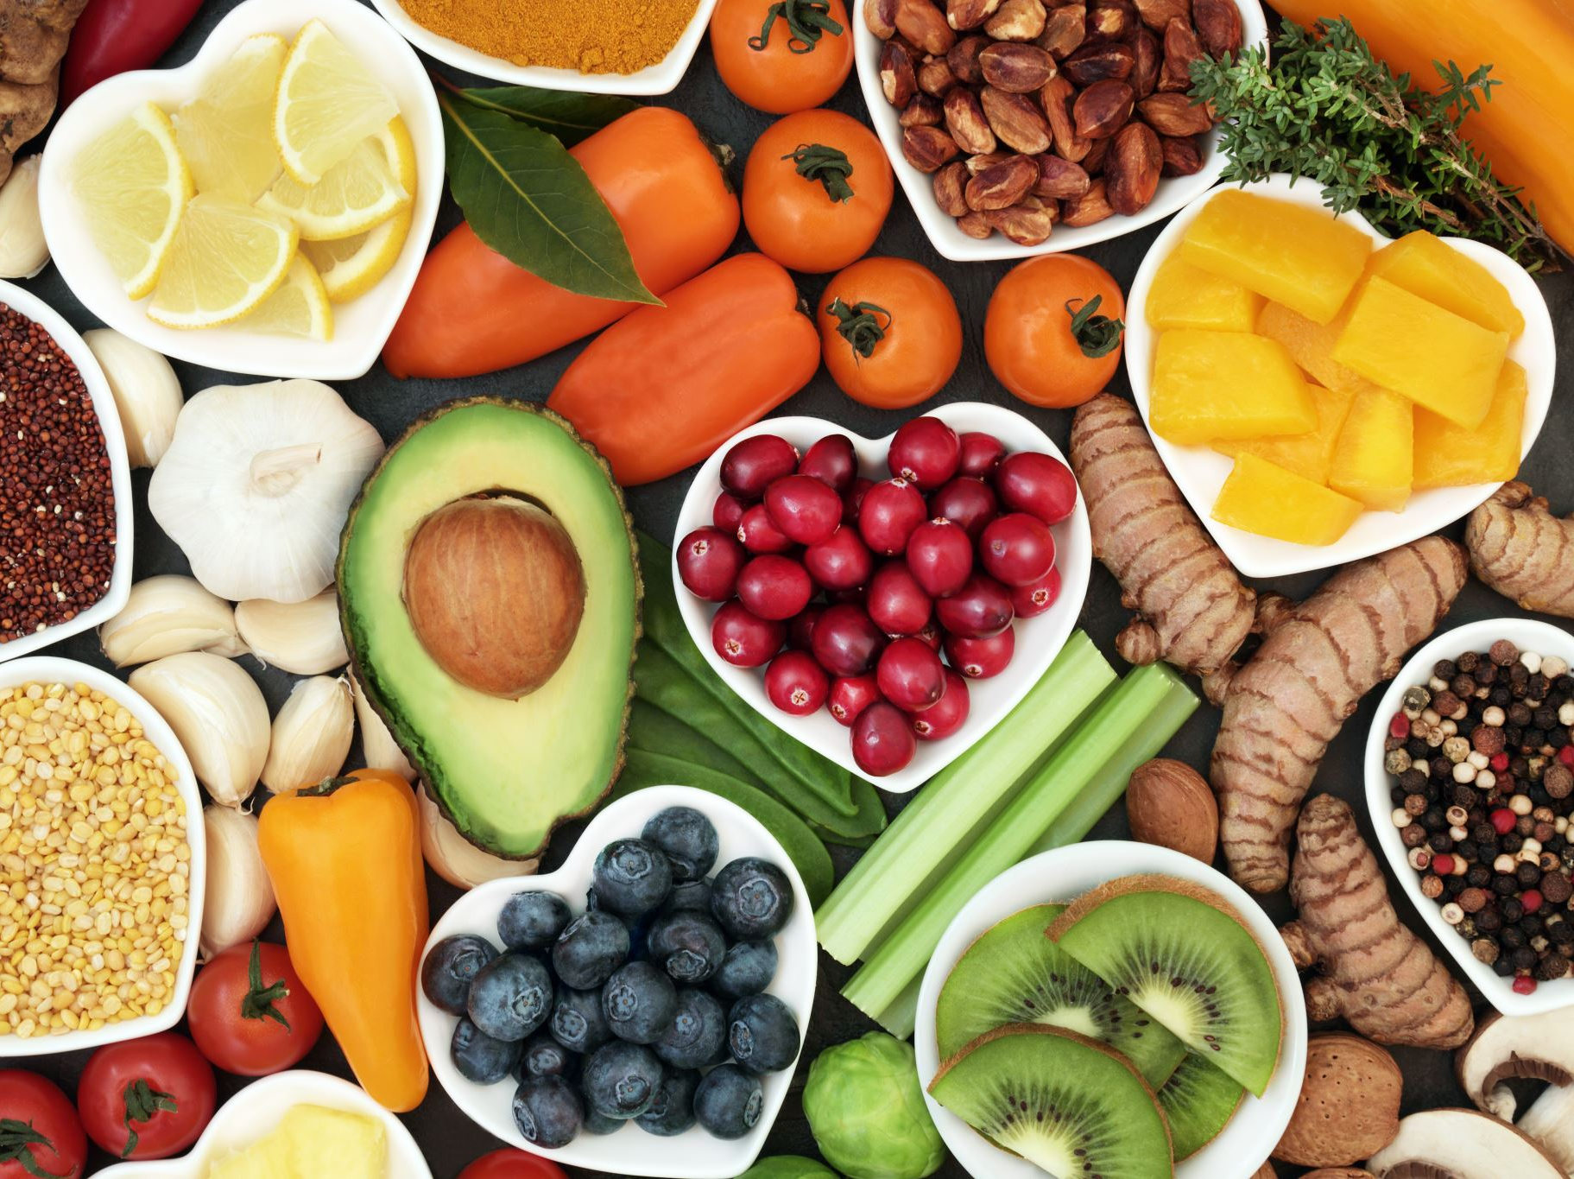
Nutrition Myths vs Facts
Myth: All fats are bad.
Fact: Healthy fats are essential.
Myth: Skipping meals causes weight loss.
Fact: Often leads to overeating later.
Myth: Not eating can be detrimental
Fact: Intermittent fasting can eliminate glucose spikes and be beneficial to the body

Slide 6
Carbohydrates: The Body's Primary Fuel
• Glucose fuels the brain and muscles.
• Choose whole grains, fruits, and vegetables over refined sugars.
• Carbohydrates break down into glucose.

Slide 7
Protein: Building and Repair
• Protein breaks into amino acids.
• Supports muscles, hormones, immune system, and tissue repair.
• Sources: meat, fish, eggs, dairy, beans, legumes.

Slide 8
Healthy Fats
• Support hormones, brain function, and vitamin absorption.
• Sources: olive oil, nuts, seeds, avocados, fatty fish.
• Limit trans fats.

Slide 9
Sugar & Insulin Resistance
• Excess sugar may contribute to weight gain and insulin resistance.
• Frequent blood sugar spikes can affect energy and appetite.
• Limit sugary beverages.

Slide 10
Reading Nutrition Labels
* Focusing on overall nutrient quality helps people make better long-term choices.
Check:
Serving size.
Fiber
Protein
Sodium
Calories
Added sugar

Slide 11
Healthy Eating on a Budget
Buy seasonal produce.
Purchase frozen vegetables.
Use beans and lentils.
Plan meals before shopping.

Slide 12
Meal Planning for Singles
Cook once, eat multiple times.
Prepare healthy snacks.
Freeze leftovers.
Use a weekly meal calendar.

Slide 13
30-Day Nutrition Challenge
Drink more water.
Add vegetables daily.
Eat more whole foods
Reduce processed foods
Reduce sugary drinks.
Track one nutrition goal for 30 days.

Slide 14

Resources
• USDA MyPlate
• Registered Dietitians
• Dr. Boz
• Dr. Berg
• CDC Nutrition Resources

Slide 15
About the Document
The Thriving Solo series was developed from a passion for helping individuals thrive in every stage of life. The author holds a Master of Business Administration (MBA) and has experience in business analysis, project management, technology, operations, and financial planning concepts. Throughout a diverse career and life journey, the author has developed a deep appreciation for the importance of lifelong learning, personal growth, health, financial stewardship, meaningful relationships, and spiritual development. These experiences, combined with extensive independent research and a desire to help others succeed, inspired the creation of the Thriving Solo curriculum and community resources.
Recognizing that single adults often face unique opportunities and challenges, these resources are designed to help readers build confidence, make informed decisions, strengthen relationships, improve overall well-being, and live with greater purpose.
The goal of Thriving Solo is not simply to share information, but to inspire growth, wisdom, resilience, and meaningful connections. Through education, discussion, and practical action steps, readers are encouraged to develop a balanced life that supports financial stability, physical health, emotional wellness, intellectual growth, social engagement, and spiritual development.
The author believes that every stage of life presents opportunities to learn, contribute, and flourish. Whether you are single by choice, circumstance, divorce, widowhood, or simply navigating a new season of life, this material was created to encourage and equip you for the journey ahead.
For additional resources, workshops, and educational materials, visit the Thriving Solo website and community platform.

