Slide 1

Health for Singles

Slide 2
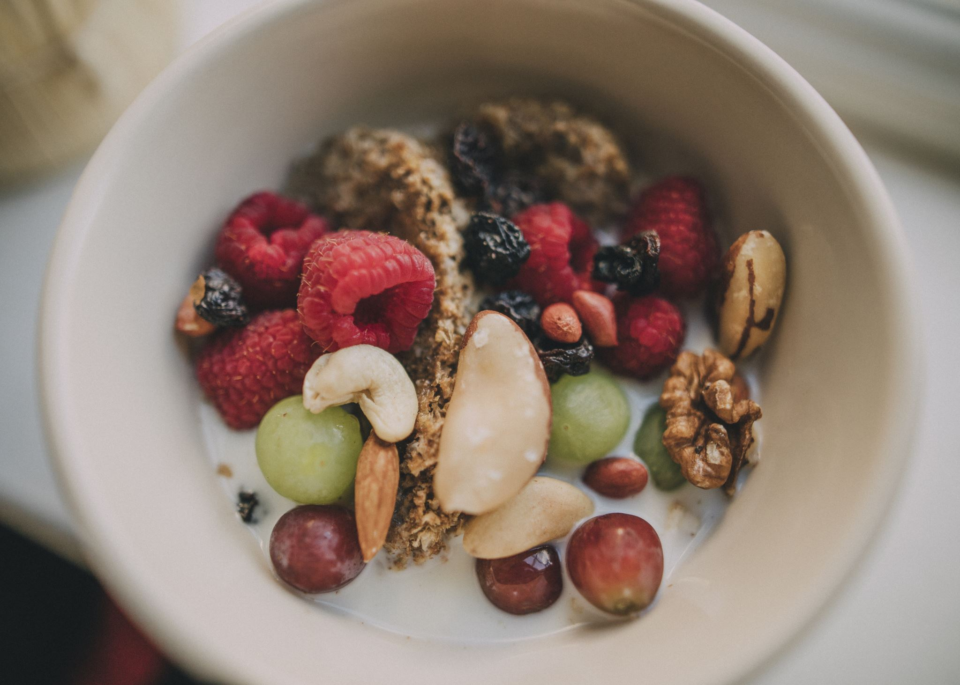
Healthy Living Across the Lifespan
• Most chronic diseases develop over years.
• Lifestyle choices today influence future health.
• Prevention is often more effective than treatment.

Slide 3
Ages 18–34: Build Your Foundation
Common issues:
• Anxiety/depression
• Obesity
• Asthma
• Early hypertension
Focus:
• Exercise 150 min/week
• Strength training
• Healthy eating
• Sleep 7–9 hours

Slide 4
Ages 35–49: Prevent Chronic Disease
Common issues:
• High blood pressure
• High cholesterol
• Type 2 diabetes
• Fatty liver
Focus:
• Weight management
• Routine checkups
• Stress management

Slide 5
Ages 50–64: Early Detection Matters
Common issues:
• Heart disease
• Arthritis
• Cancer risk rises
• Hearing/vision changes
Focus:
• Screenings
• Vaccinations
• Muscle preservation

Slide 6
Ages 65–74: Maintain Independence
Common issues:
• Stroke
• Falls
• Cataracts
• Hearing loss
Focus:
• Balance training
• Social activity
• Medication review

Slide 7
Ages 75+: Healthy Aging
Common issues:
• Frailty
• Dementia risk
• Multiple chronic illnesses
Focus:
• Protein
• Mobility
• Fall prevention

Slide 8





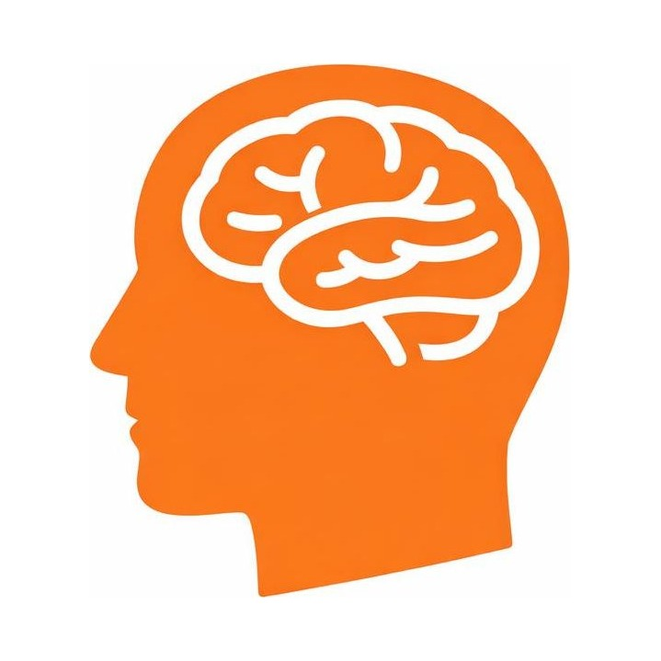

Six pillars of brain health
Lifestyle choices affect the brain and body
1. Physical Exercise
Regular movement boosts blood flow and supports memory and mood.
2. Food & Nutrition
A balanced, brain-healthy diet fuels focus and long-term cognition.
3. Medical Health
Managing blood pressure, sleep, and regular checkups protects the brain.
4. Sleep & Relaxation
Quality rest clears toxins and consolidates memory and learning.
5. Mental Fitness
Lifelong learning and new challenges build cognitive reserve.
6. Social Interaction
Staying connected lowers stress and strengthens resilience.

Slide 9
1. Physical Exercise
Increases blood flow, oxygen, and nutrients to the brain. Produces Brain Derived Neurotrophic Factor (BDNF), helping brain cells grow and connect. Reduces risk of stroke, depression, and cognitive decline.
Lowers blood pressure, improves blood sugar control, reduces inflammation, preserves muscle and balance, and supports healthy aging.
Move daily and strength train twice weekly.

Slide 10
2. Food & Nutrition
The brain uses about 20% of the body's energy. It requires healthy fats, protein, vitamins, minerals, and glucose.
Omega-3 fats support brain cell membranes. Stable blood sugar improves focus. Anti-inflammatory foods may reduce dementia and stroke risk.
Eat:
• Vegetables
• Fruit
• Lean protein
• Whole grains
• Healthy fats
Balanced meals with whole foods steady mood and focus through the day
Stay hydrated: Regular water and limited caffeine help keep your mind clear and calm

Slide 11
3. Medical Health
Healthy blood vessels are critical for brain health. Hypertension and diabetes can damage the brain over time.
High blood pressure increases stroke risk. Diabetes damages blood vessels and nerves. Untreated hearing loss is associated with cognitive decline.

Slide 12
4. Stress & Relaxation
Chronic stress increases cortisol. Excess cortisol may impair memory and increase inflammation.
Protect your sleep
Keep a consistent schedule and wind down without screens before bed.
Recognize your triggers
Notice the situations, thoughts, and body signals that flag rising stress.
Use quick resets
Deep breathing, short walks, and brief breaks calm the nervous system in minutes.
Build steady routines
Regular exercise, clear boundaries, and downtime lower your baseline stress.
Practice Meditation
ease anxiety, sharpen focus, and improve sleep.

Slide 13
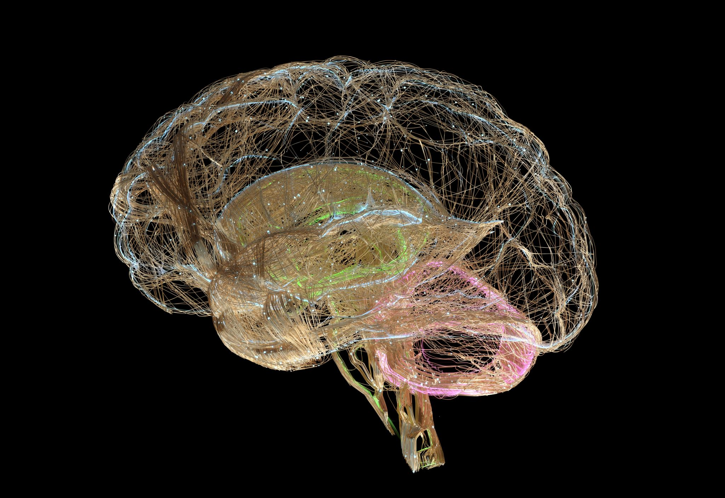
5. Mental Fitness
The brain changes throughout life through neuroplasticity. Learning creates new neural connections.
Activities such as Reading, puzzles, learning a language, music, technology skills, and strategy games can help

Slide 14

6. Social Interaction
Positive relationships stimulate:
  dopamine
  serotonin
  oxytocin
Social connection improves resilience and emotional health.
Loneliness is associated with
  depression
  higher blood pressure
  dementia risk
  poorer health outcomes
Build your circle
Shared interests and community groups create new, supportive bonds
Reach out often
Regular check-ins with friends and family ease loneliness and stress.
Give and accept support
Offering help and leaning on others both strengthen connection.
This Photo by Unknown Author is licensed under CC BY-NC-ND

Slide 15
How the Six Pillars Work Together
Exercise supplies blood flow.
Nutrition supplies fuel.
Medical health protects circulation.
Sleep repairs.
Mental fitness builds pathways.
Social interaction strengthens health.

Slide 16
What Can You Control?
Modifiable:
• Diet
• Exercise
• Sleep
• Smoking
• Alcohol
• Stress
Non-modifiable:
• Age
• Genetics
• Family history

Slide 17
Health Screenings by Age
20s–30s: BP, cholesterol if indicated
40s–50s: Diabetes, colon cancer, breast/prostate discussions
65+: Vision, hearing, bone density, fall risk

Slide 18
Healthy Habits That Add Healthy Years
• Don't smoke
• Maintain healthy weight
• Sleep well
• Stay socially connected
• Keep learning
• See your healthcare provider regularly

Slide 19
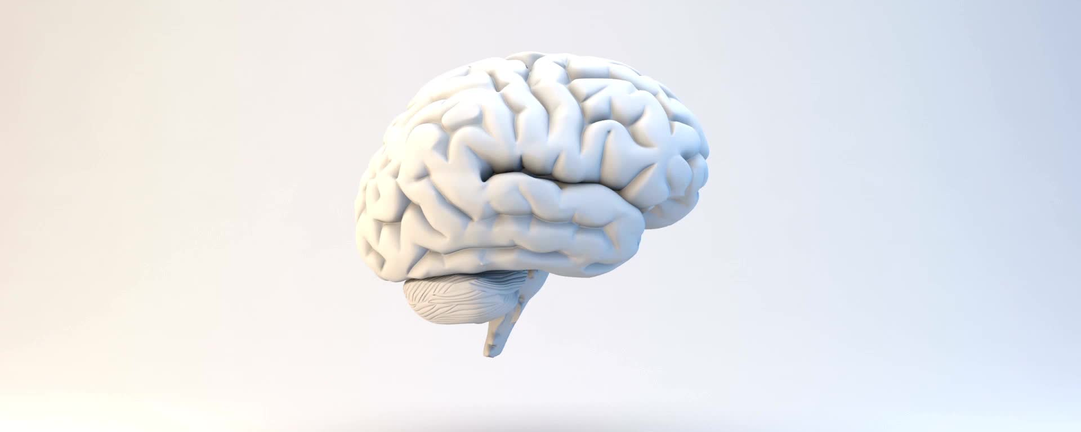
30-Day Brain Health Challenge
Choose one improvement in each pillar and track progress for 30 days

Slide 20
Additional Steps
Talk to a professional
Therapists and counselors offer tools tailored to your needs.
Use helplines
Free, confidential support lines are available any time you need them.
Explore self-help tools
Apps, books, and online programs reinforce healthy daily habits.

Slide 21

Resources
Trusted sources:
Center For Disease Control (CDC)
National Institute of Health (NIH)
American Heart Association
Alzheimer's Association
USDA MyPlate

Slide 22
About the Document
The Thriving Solo series was developed from a passion for helping individuals thrive in every stage of life. Drawing from personal experiences, years of research, professional development, faith-based study, and a commitment to lifelong learning, the author seeks to provide practical, encouraging, and easy-to-understand information on finances, nutrition, exercise, health, and spirituality.
Recognizing that single adults often face unique opportunities and challenges, these resources are designed to help readers build confidence, make informed decisions, strengthen relationships, improve overall well-being, and live with greater purpose.
The goal of Thriving Solo is not simply to share information, but to inspire growth, wisdom, resilience, and meaningful connections. Through education, discussion, and practical action steps, readers are encouraged to develop a balanced life that supports financial stability, physical health, emotional wellness, intellectual growth, social engagement, and spiritual development.
The author believes that every stage of life presents opportunities to learn, contribute, and flourish. Whether you are single by choice, circumstance, divorce, widowhood, or simply navigating a new season of life, this material was created to encourage and equip you for the journey ahead.
For additional resources, workshops, and educational materials, visit the Thriving Solo website and community platform.

