Slide 1
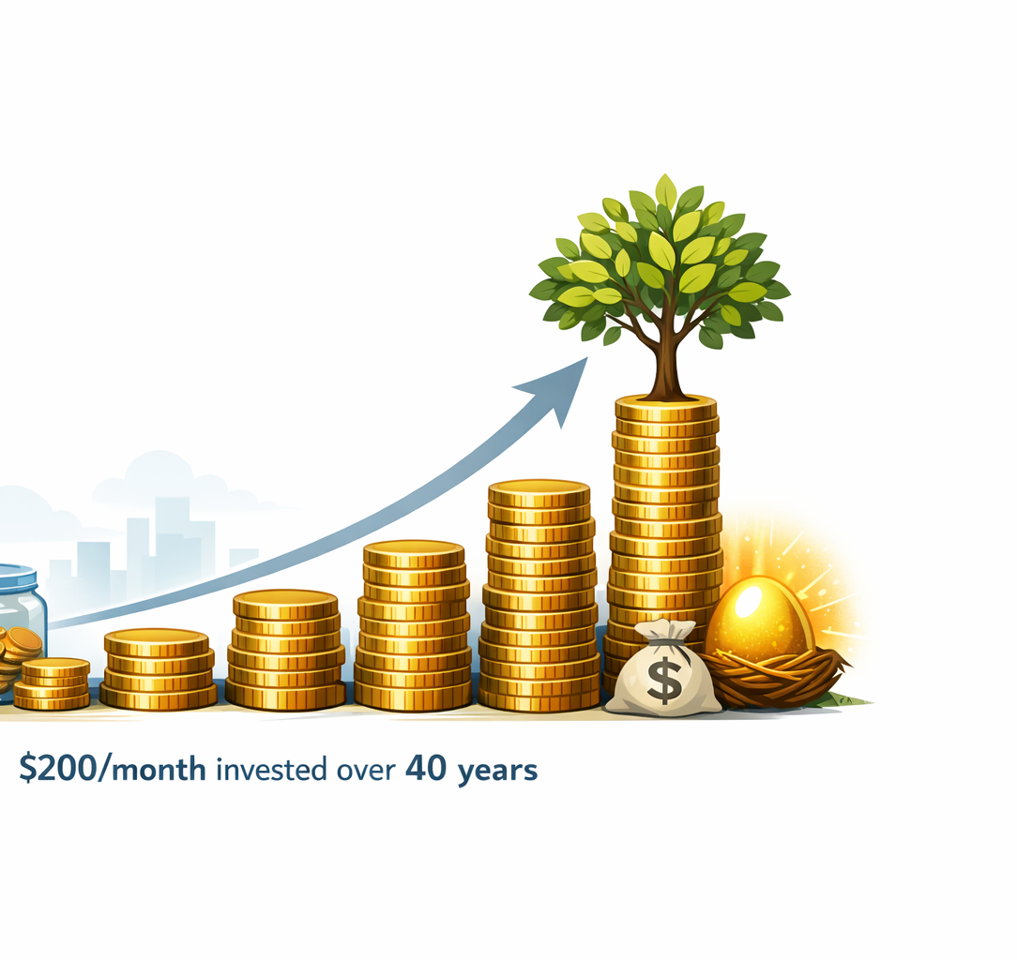
Successful Singles Financial Foundations
Building financial confidence

Slide 2
Why Financial Literacy Matters
Money affects nearly every life decision

Slide 3
Living Below Your Means
Freedom over Appearances

Slide 4

Budgeting
Give every dollar a job

Slide 5

Emergency Funds
Emergencies happen regularly
Save 3-6 months expenses

Slide 6
What Is a Credit Score?
FICO® scores range from 300 to 850
Poor
300–579
Fair
580–669
Good
670–739
Very Good
740–799
Exceptional
800–850
A credit score helps lenders evaluate how likely you are to repay debt.
It can determine whether you qualify for a mortgage or car loan—and how much that borrowing will cost you over time.
718
Average U.S. credit score
760+
Usually earns the best rates
The right score can be the difference between getting a loan or not—and can translate into paying, or saving, thousands of dollars over time.

Slide 7
What Your Credit Score Is Based On
FICO and VantageScore calculate scores a little differently, but in general five factors drive your number. Here are recent FICO weightings:
Payment history
35%
Amounts owed
30%
Length of credit history
15%
New credit
10%
Types of credit used
10%

Slide 8
7 Ways to Improve Your Credit Score
Whether your credit is thin or needs repair, these habits can bring your score up—and keep it there.
1
Pay your bills on time
Late or missed payments hurt your score most—automate payments to stay current.
5
Aim for a longer history
Keep older accounts open and in good standing to raise the average age of your credit.
2
Keep your balances low
Stay under 30% of your credit limit, and pay off what you charge each month.
6
Check your report regularly
Get a free annual report from Experian, Equifax, and TransUnion to catch errors early.
3
Be cautious with new credit
Each application can trigger a hard inquiry and make lenders see you as higher risk.
7
Dispute any errors
Correct inaccuracies, and consider freezing your credit to guard against identity theft.
4
Use a mix of credit types
Cards, an auto loan, student loans, or a mortgage can all strengthen your profile.

Slide 9
Employer Benefits
Don't leave free money on the table
Examples include 401k match, Flexible Spending Account (FSA), Health Savings Account (HSA) contributions, parking subsidies, etc.

Slide 10

401(k) Matching
One of the best investment opportunities
Take advantage of company matching (free money)
Some companies allow Roth contributions
Compounding

Slide 11

Traditional vs Roth
Current taxes vs future taxes
Taxes are paid initially for Roth but grow tax-free
Limiting lifetime taxes is more important than minimizing taxes for one year and should be considered in all decisions
Have a variety of taxable vs non-taxable resources to mitigate Required Minimum Distributions (RMDs) and IRMAA surcharges in retirement

Slide 12

Health Savings Accounts
Only Triple tax advantaged account
Only available with High Deductible Plan
Money should be invested

Slide 13

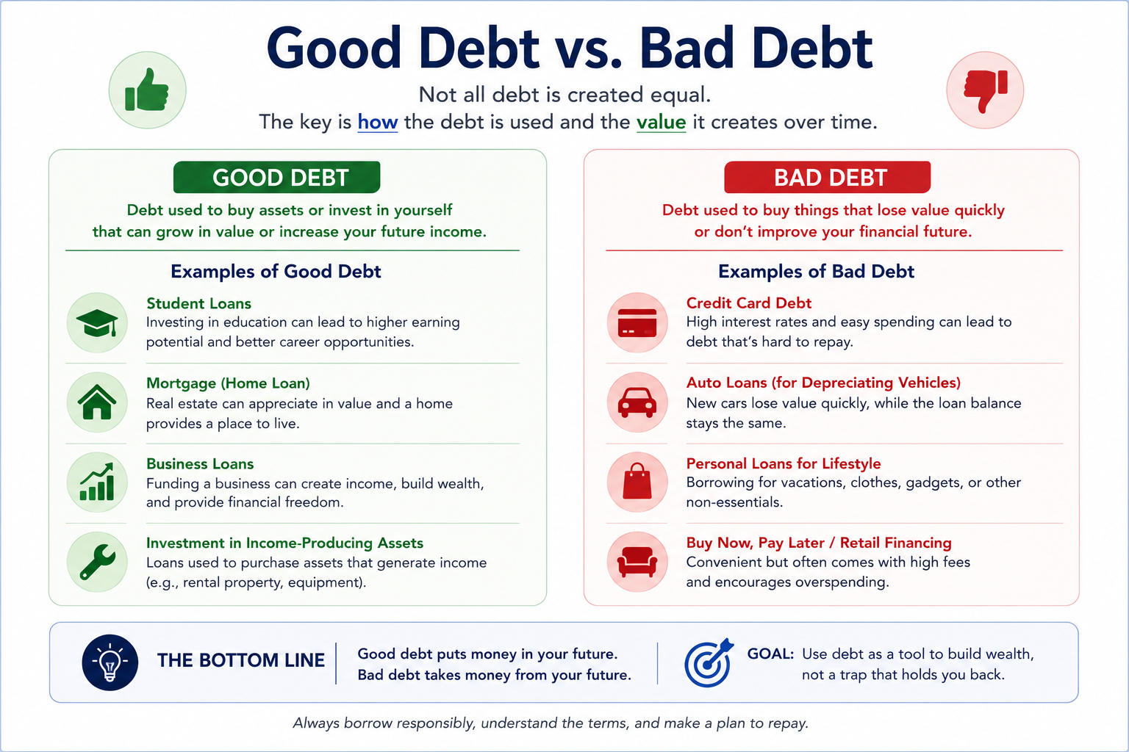
Social Security
How your benefit is calculated
Top 35 years of earnings are indexed for wage growth.
Averaged into a monthly figure (your AIME) with inflation-adjusted amounts earned prior to 60.
A bend-point formula sets your full benefit (PIA).
Claiming age adjusts it—less at 62, more if you wait to 70.

Slide 14

Investment Basics
Stocks
bonds
ETFs (Exchange Traded Funds)
Mutual Funds
Fees impact wealth

Slide 15

Compounding
The 8th wonder of the world

Slide 16
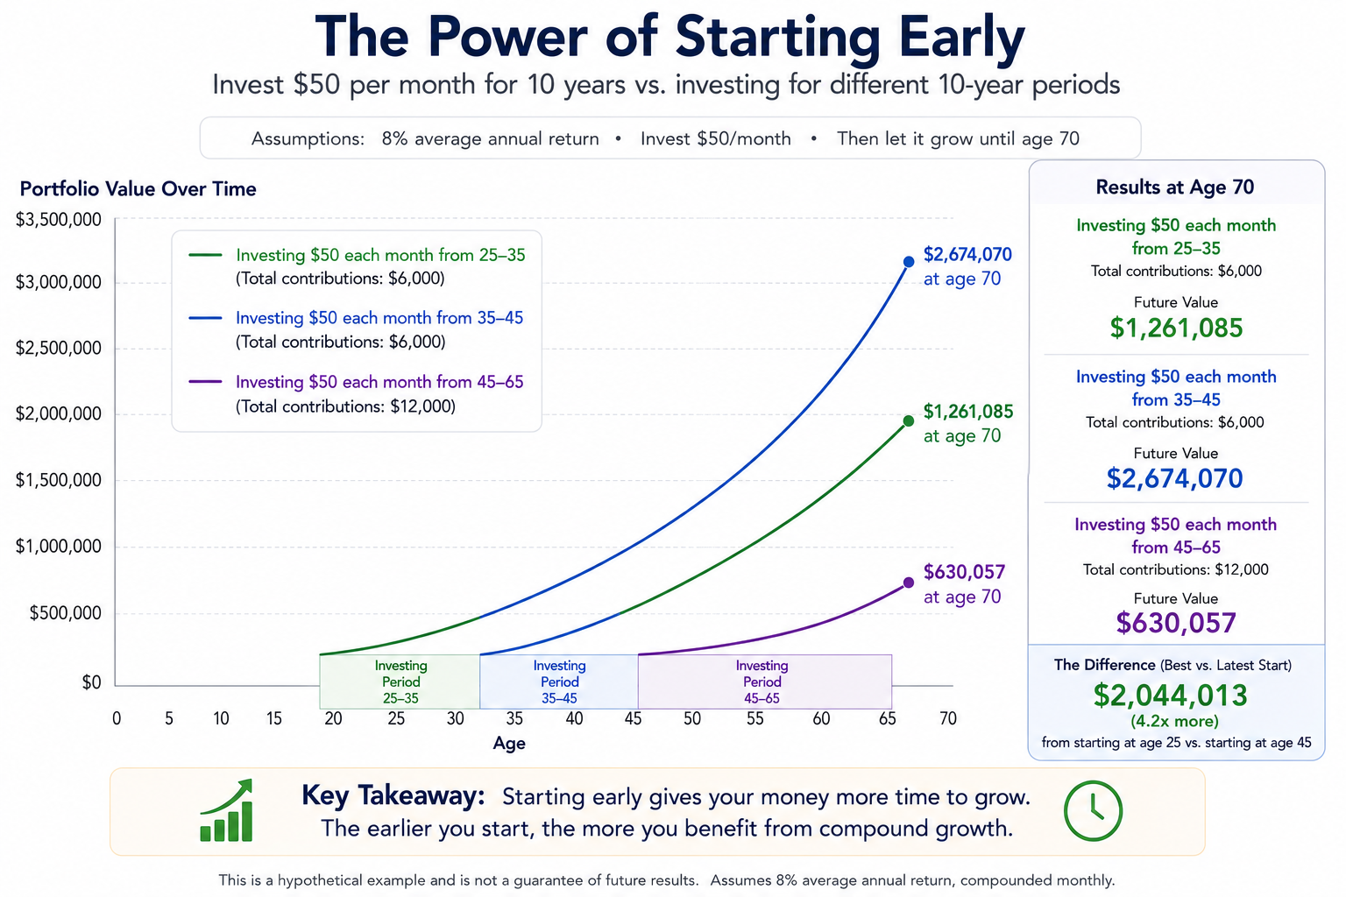

Slide 17

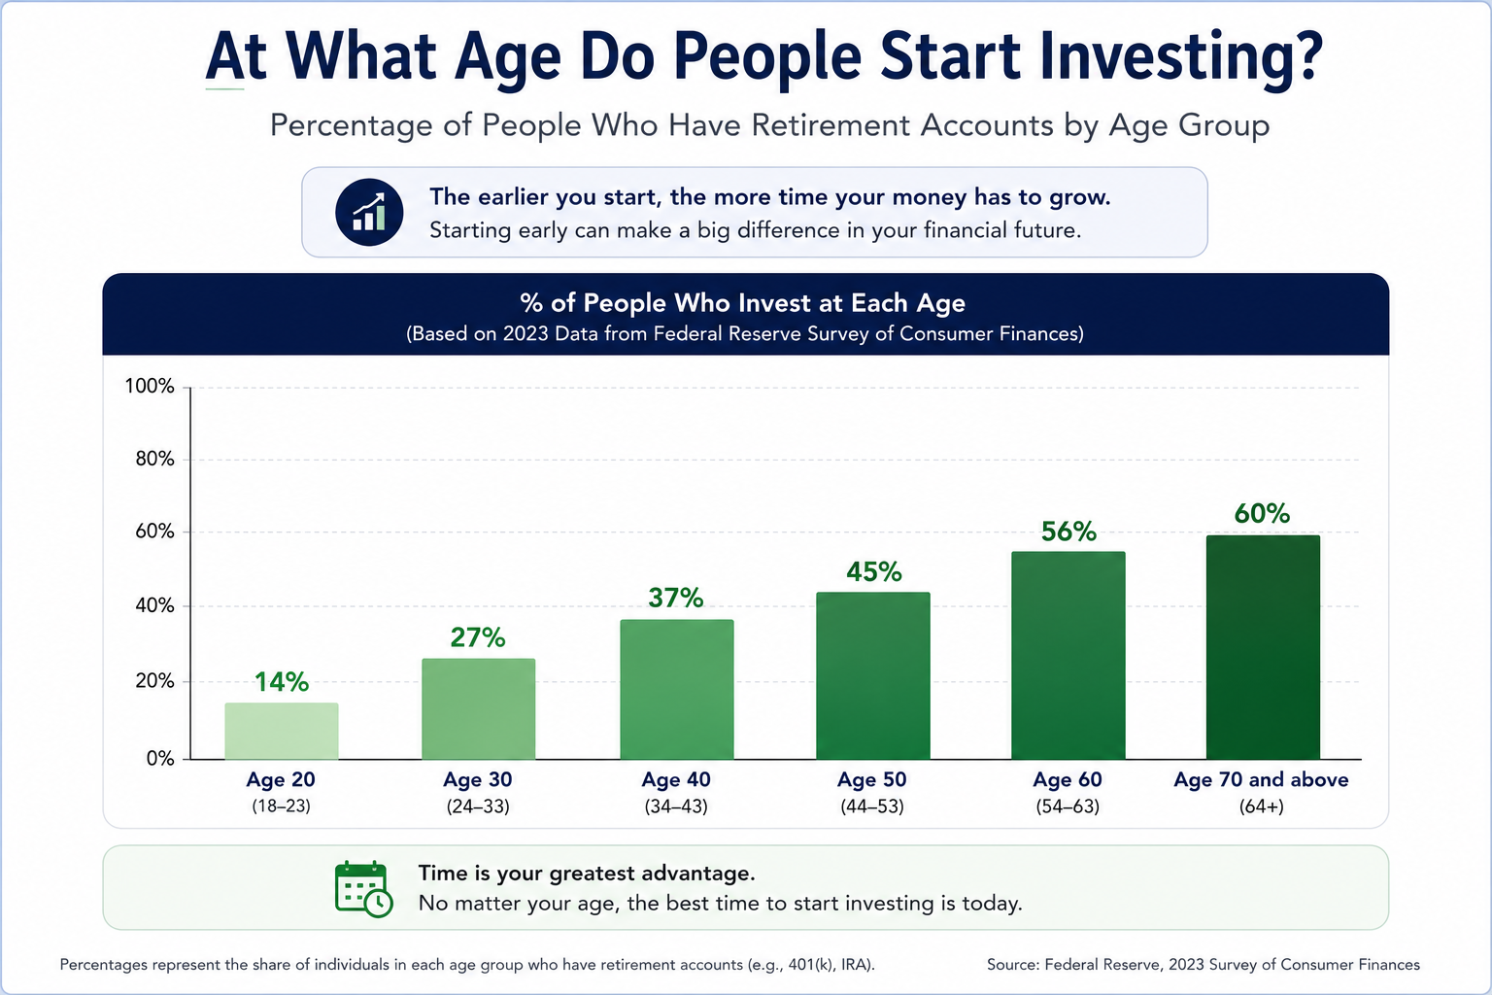
Diversification
The best time to invest is 20 years ago. The next best time is today
Reduce unnecessary risk

Slide 18
Beneficiaries
Keep them updated
Listed beneficiaries take precedence over Wills/Trusts

Slide 19

Essential Documents

Slide 20
Essential Documents to Have
Beyond your will and trust, keep these organized and accessible.
Estate planning
Last will & testament directs who gets what.
Revocable living trust helps avoid probate.
Powers of attorney
Durable financial POA lets someone manage money if you can't.
Healthcare (medical) POA names who decides your care.
Health directives
Living will / advance directive states your end-of-life wishes.
HIPAA authorization lets providers share records with loved ones.
Records & designations
Beneficiary designations kept current on accounts and policies.
Letter of instruction guides your family on next steps.
Vital records & account list (IDs, deeds, titles, insurance).

Slide 21
Financial Mistakes to Avoid
Bad Debt
Lifestyle inflation
No plan

Slide 22

Action Plan
Start today
Review goals and accounts
Know where your money is going

Slide 23
About the Document
The Thriving Solo series was developed from a passion for helping individuals thrive in every stage of life. The author holds a Master of Business Administration (MBA) and has experience in business analysis, project management, technology, operations, and financial planning concepts. Throughout a diverse career and life journey, the author has developed a deep appreciation for the importance of lifelong learning, personal growth, health, financial stewardship, meaningful relationships, and spiritual development. These experiences, combined with extensive independent research and a desire to help others succeed, inspired the creation of the Thriving Solo curriculum and community resources.
Recognizing that single adults often face unique opportunities and challenges, these resources are designed to help readers build confidence, make informed decisions, strengthen relationships, improve overall well-being, and live with greater purpose.
The goal of Thriving Solo is not simply to share information, but to inspire growth, wisdom, resilience, and meaningful connections. Through education, discussion, and practical action steps, readers are encouraged to develop a balanced life that supports financial stability, physical health, emotional wellness, intellectual growth, social engagement, and spiritual development.
The author believes that every stage of life presents opportunities to learn, contribute, and flourish. Whether you are single by choice, circumstance, divorce, widowhood, or simply navigating a new season of life, this material was created to encourage and equip you for the journey ahead.
For additional resources, workshops, and educational materials, visit the Thriving Solo website and community platform.

